Slide 1
Humour Analysis on Online Crowdsourced Content
7/11
Avery, Scarlett, Casidhe, Malcolm, Dickson

Slide 2
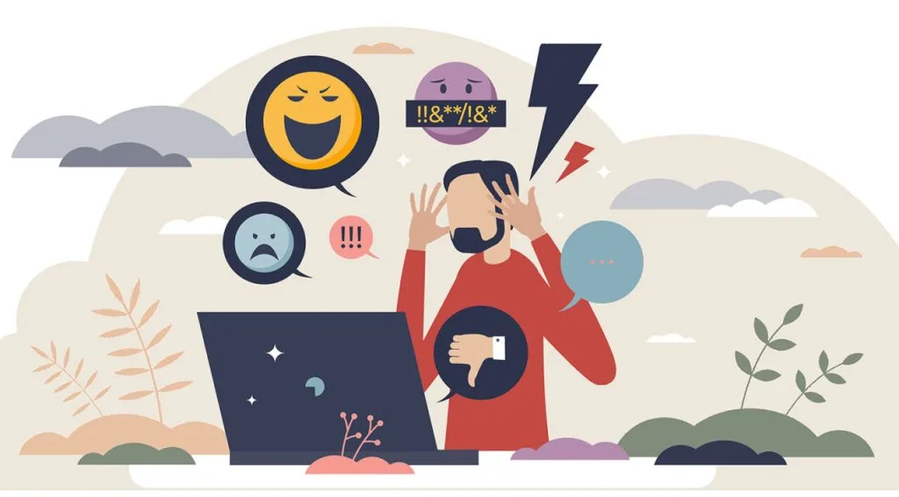
Mission Statement
Humour is prevalent in online textual content but can also be a source of trolling and negativity.
Understanding humor can often help eradicate discrimination, harassment and cyberbullying in online spheres.
I’ve got a friend who has got a butler whose left arm is missing, serves him right!
Yelled at some skinhead today & he was like “chemotherapy dude” & I was like “whatever, racist!” cause sometimes you gotta take a stand!
Did you hear about a terrorist with house fetish? He blew his house.
Notes:
humour is a prevalent theme among textual content written and shared online but can also be a tool to mask negative stereotypes, pejoratives and rhetoric that can otherwise promote discrimination, harassment, cyber-bullying and foster feelings of social exclusion. Hence humor understanding and generation has been of considerable academic interest in recent years and is the central theme of our project.

Slide 3
Research Questions
How can we effectively identify and categorize offensive or harmful text?
What annotation framework can be adopted to comprehensively understand humor in online speech?
How well do state-of-the-art language models perform in humour understanding tasks?
Notes:
(2 or 3 questions), Avery

Slide 4
Objective
Propose a novel annotation framework for comprehensive humor understanding.
Produce a labelled dataset to benchmark humor annotation tasks.
Use NLP to classify a dataset of jokes in textual format into categories that helps identify negative effects.
Performance analysis of Large Language Models (LLMs) on humour annotation.
Notes:
Avery
Performance analysis of state-of-the-art LLMs on online humour to see how effective existing models are when we adopt this framework to label online humorous content. This would also help us understand if any alterations need to be made to the proposed annotation framework for it to be reproducible by popular language models.

Slide 5
Solutions
Annotation Task
Literature reviews and background research on constructing a comprehensive humor annotation framework.
Annotated dataset of jokes from crowdsourced content
Language Task- Humor annotation with LLMs
Prompt Engineering
Fine Tuning
Performance in language task informs us of the feasibility of annotation structure in practice
Notes:
Explain differences btw fine tuning + prompt engineering(need because not enough data), Casidhe → mention that an outcome of this work is to provide a labelled dataset to aid benchmarking tests in humor understanding tasks. But building large-scale labelled datasets takes time and is expensive due to the human labor involved. Hence prompt engineering is an appropriate approach at the onset.

Slide 6
Plan of Action
Goal
Step 1
Step 2
Step 3
Step 4
Background Research & Lit Review
Model testing and annotation work
Performance Analysis
Finalize Deliverables
Produce a comprehensive Humour Understanding framework
Notes:
*background (Dickson)

Slide 7
Challenges with Annotating Humor
Potential challenges
How we’ll respond
Humor is subjective, some people do not have the same view on jokes.
Analyze each joke carefully and have two independent annotators to review it.
A mediator resolves annotation disputes.
1
May be difficult to decide whether or not a joke is offensive.
Set clear guidelines/ definitions for each mode of categorization.
Uniformity and consistency are key.
2
Analyzing each joke in the data set is time consuming.
Incremental approach to annotation and testing
3
Notes:
Casidhe
Explain annotation fw, (Motivation) , (what labels fall under each category)

Slide 8
Annotation Framework
Categories
Classification Tasks
1
Classification - 5 Labels
Binary → Multi Class
2
Target - 11 Labels
Multi Class
3
Rhetoric - 15 Labels
Multi Class
Notes:
Explain why each classification category is important, Target, Stereotype, offensive/provocative, normal, not a joke, other Target: Body image, religious beliefs, political beliefs, gender
3 main bullets. How many labels
are in each classification… *leads to 3 types of classification tasks for each model to perform *questionnaire *Malcolm

Slide 9
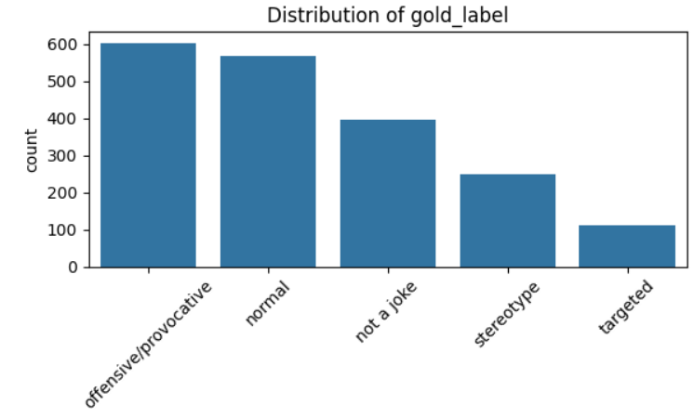
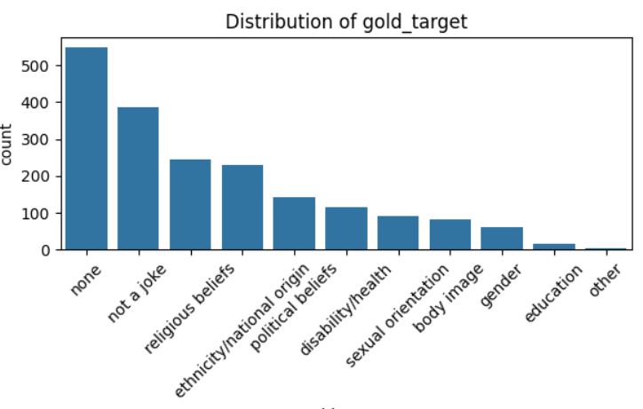
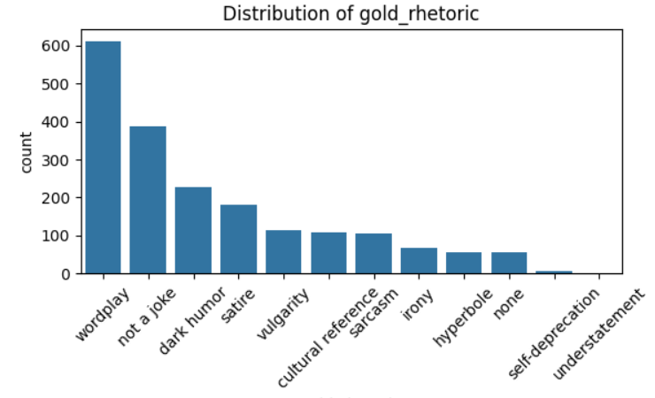
Data Source: Kaggle
Data Collection and Overview
Dataset:
1921 labeled jokes for training
2538 unlabeled jokes for testing
Goal: produce additional labeled dataset of 2.5k jokes by the end of the work
Notes:
(Scarlett) detailed annotation guide w/ definition of adopted labels will be provided as a project deliverable
the dataset was scraped by selecting examples at random from a large crowdsourced collection of jokes available on Kaggle with over 400K examples

Slide 10
Prompt Engineering
Phase 1
Phase 2
Phase 3
Objectives
Solutions
Deliverables
Learn how prompt engineering can help detect bias in jokes
Write prompts to help the model label jokes by stereotype, target, and rhetoric.
Evaluate model performance and plan ways to improve it.
Model testing
Chose OpenAI for accuracy and ease of use
Tested zero-shot, few-shot, and batch prompts
Adjusted temperature to see how it affected accuracy
Compare model labels to human labels
Annotated notes from model testing
Documentation of prompt structure and examples
Working prompts
Final dataset with model-generated labels
Notes:
Model Testing: Tested OpenAI, Mistral, Gemini, and LLaMA. *Malcolm

Slide 11
Fine Tuning
Phase 1
Phase 2
Phase 3
Objectives
Solutions
Deliverables
Conduct background research
Create and train models
Test and refine models.
Use a Transformer Ranker to find the most suitable pretrained model(s)
Binary and Multi-class classification Models Training on different columns
Model Testing
Pretrained Model Selections
Fine-tuned Models
Performance Analysis
Annotation Refinement
Notes:
(Scarlett Phase 1) 17 most popular used on hugging face (Microsoft DeBERTa v3 improved version as bert model)
Phase two and 3- Avery

Slide 12
Questions?

